Slide 1
Day 1 - Introduction
React JS, JavaScript and Node JS

Slide 2

What is React?
React is a JavaScript library for building dynamic user interfaces.
It was developed at Facebook in 2011.
And open-Sourced in 2013.
React is the most widely used front-end framework.
React is declarative.
Used to build web and native mobile and desktop applications.

Slide 3
Library vs Framework
Library
Framework
Library is a collection of pre-written code, routines, and functions that can be used to perform specific operations.
Call specific method or function to perform a task.
The control flow of the application remains with the developer.
Example: React JS, jQuery.
Framework is a more comprehensive set of tools, rules, and conventions that provide a particular structure to build applications.
Write code within the specific framework’s design.
The framework decides the control flow and developer fill in their code.
Example: Angular, Next JS.

Slide 4
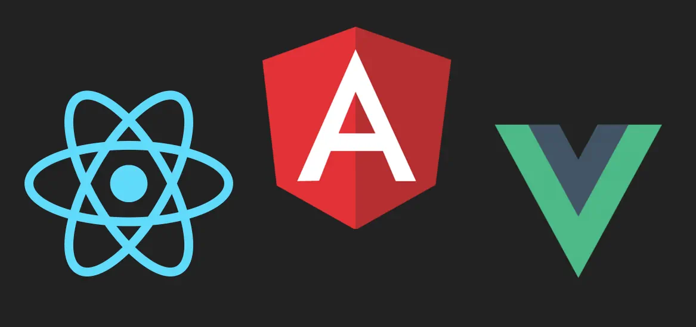
React vs Angular vs Vue

Slide 5
JavaScript Essentials
Functions and Arrow Functions
Template Literals / String Literals
Callback functions
Array Methods (filter and map)
Object Destructuring
Array Destructuring
Spread Operator
Imports and Exports

Slide 6

What is NodeJS?
Node JS is an open-source, cross platform, javascript runtime environment.
Node.js runs the V8 JavaScript engine, the core of Google Chrome, outside of the browser.
Application: Server-side, IOT applications, Streaming applications, CMS, e-commerce.

Slide 7
Working of Browser
V8 Engine
Browser API
DOM
Timers
Etc.,
Event Loop
Callback Queue

Slide 8
JS Engine
Call Stack: The call stack is where JavaScript keeps track of function calls. When a function is called, it's added to the top of the stack, and when it returns, it's removed from the stack. The call stack is synchronous and works in a last-in, first-out (LIFO) manner.
Callback Queue (Task Queue): The callback queue is also known as the task queue. It stores functions (callbacks) that are ready to be executed. These functions are usually added to the queue after completing asynchronous operations, such as I/O, timers, or network requests.
Event Loop: The event loop is a continuous process that constantly checks the call stack and the callback queue. It's responsible for moving functions from the callback queue to the call stack, effectively scheduling and executing asynchronous operations.

Slide 9
Ways to create a react app
Create react app
Official way to create a react project.
npx create-react-app <my-app>
Vite
A frontend tooling
npm create vite@latest / @version_number
NextJS
A fullstack web framework on top of react
Npx create-next-app@latest

Slide 10
React DOM
React DOM is a library for interacting with actual DOM of the browser.
It serves as the interface between React components and the Document Object Model (DOM) in web browsers.
ReactDOM.render()
ReactDOM.createRoot()

Slide 11
Components
React is built on a component-based architecture.
The UI is broken down into reusable components, each responsible for rendering a part of the UI.
Components can be nested within each other, promoting reusability and maintainability.
Types of Components
Functional Components
Class Components (deprecated)

Slide 12

NPM
A package manager for managing software dependencies and packages.
Package.json is npm’s configuration file.
It’s a Json file that can be found in root directory of a project and it holds various meta data.
It has the detailed overview of the project.

Slide 13
Webpack
Webpack is a popular module bundler for JavaScript applications.
It takes different modules with dependencies and generates static assets.
It is used to efficiently manage, bundle, and serve web application resources.
To install: npm install webpack webpack-cli
To setup:
const path = require("path");
module.exports = {
entry: "./app.js",
output: {
path: path.resolve(__dirname, "dist"),
filename: "bundle.js",
},
};
To compile: npx webpack --config webpack.config.js

Slide 14
Babel
Babel is a JavaScript transpiler widely used in modern web development and ReactJS.
It allows developers to write code using the latest JavaScript syntax (such as ES6/ES2015) without worrying about compatibility issues with older browsers that might not support these newer features.
Babel can also transpile JSX into JavaScript code.

Slide 15
JSX Limitations
JSX requires compilation before running in the browser.
Self-closing tags should include a trailing slash.
Potential naming conflicts with reserved words (e.g., class vs. className).
Wrapping elements in parentheses when multiple elements are returned.
No direct HTML comments; use {/* ... */}.

Slide 16
JSX
JSX (JavaScript XML) is a syntax extension for JavaScript often used with React.
JSX allows you to write HTML-like code within your JavaScript code.
This makes easier to define the structure of your UI components.
JSX is not limited to React and can be used in other JavaScript frameworks as well.

Slide 17
END

